Slide 1



DRAG & DROP
LOGO HERE
Earn and Save for ORG NAME with FlipGive
Benefits of joining ORGANIZATION NAME’S FlipGive Program
© 2026 FLIPGIVE

Slide 2


Fuel fundraising with everyday purchases
SHOP | DINE | TRAVEL
FlipGive's Everyday Earnings Engine lets you fundraise through shopping, dining, and travel, without selling anything or spending extra. It fits into what you're already doing, so you have more time to do what you love.

Slide 3


Benefits of Earning Money with FlipGive
It’s Easy—FlipGive fits right into your daily life with opportunities to earn anywhere you shop, dine, or travel.
It’s Effective—Brands automatically give up to 20% back to our group. Earnings are shared with you to offset costs.
It’s Limitless—Each family can earn hundreds of dollars per year toward expenses.
It’s Flexible—With eGift cards, a mobile app, and a browser extension, earning can happen anywhere, anytime.

Slide 4



How to earn with eGift cards
You buy eGift cards
You get the full value—no extra money comes out of your pocket. Choose from hundreds of popular brands.
Earn money simply by using eGift cards to pay for everyday purchases, instead of cash or credit cards.
The brand gives back
A percentage of every gift card purchase automatically goes back to our group as earnings.
Earnings go toward expenses
Our organization shares earnings with participating families to offset costs.

Slide 5
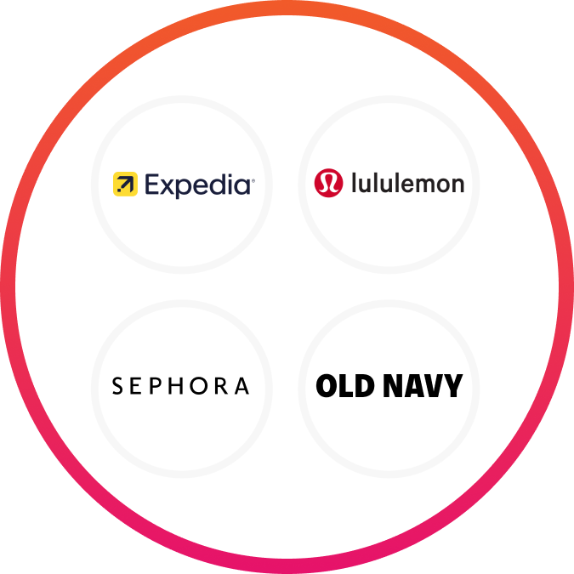
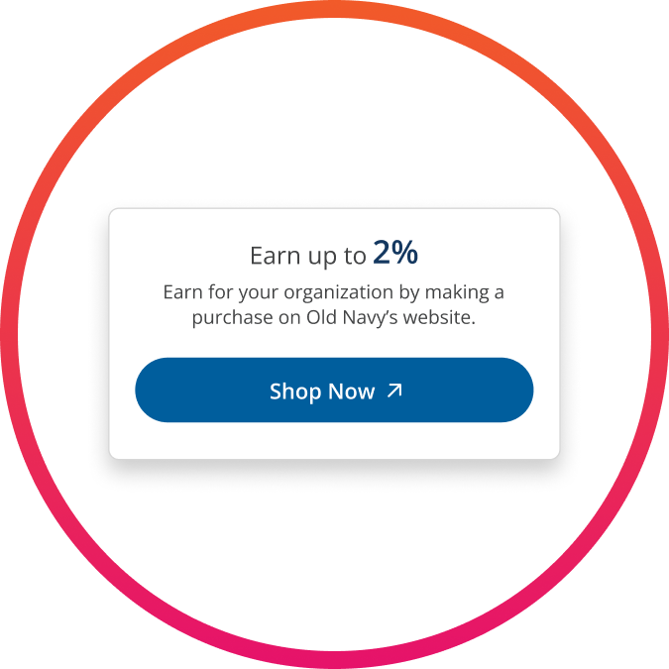
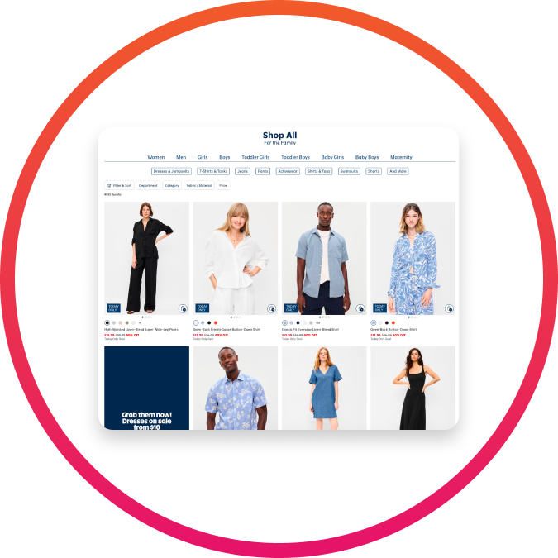
Select a Brand
How to earn on online shopping
Browse hundreds of brands on FlipGive.com or the FlipGive mobile app that offer online earnings.
Earn money simply by shopping online through FlipGive.
Go shopping
Click through to the brand’s website, and shop like you normally do.
Earn
Automatically earn by completing a purchase on the brand’s website.

Slide 6
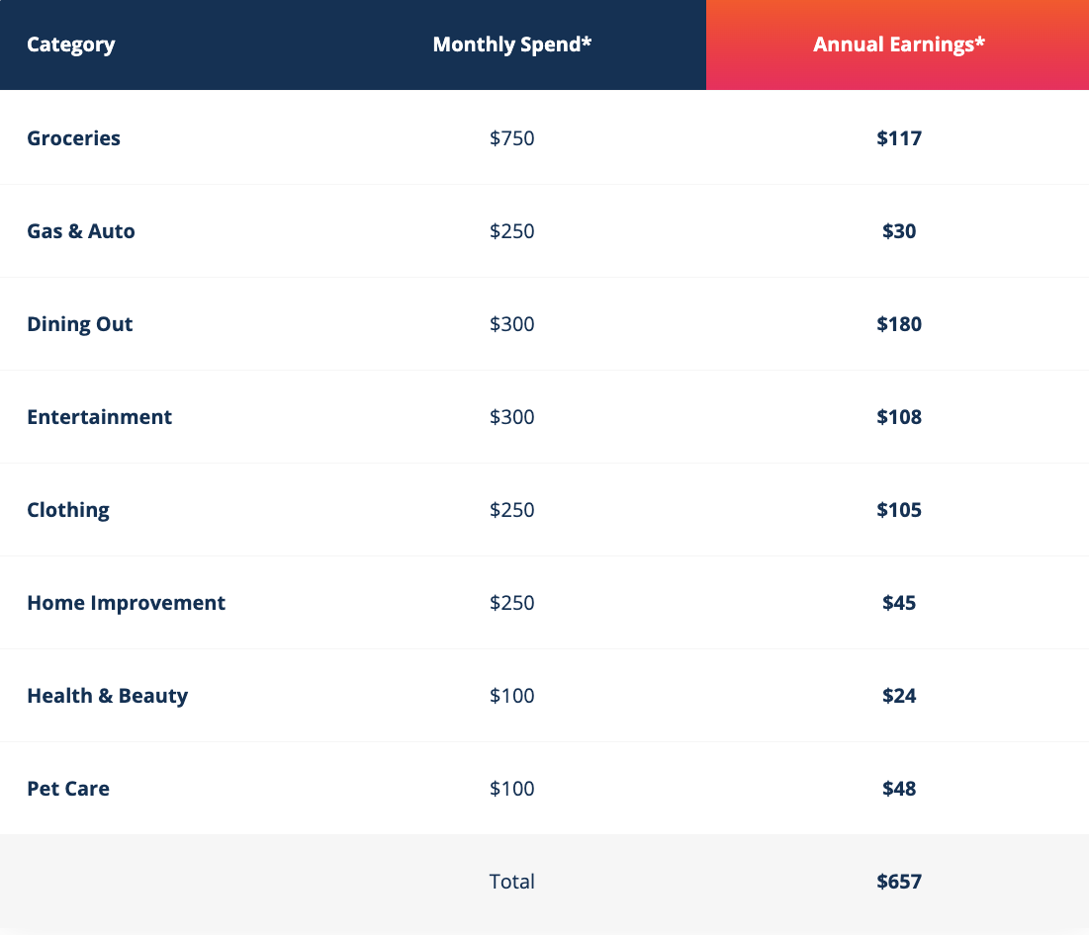
Everyday expenses = everyday earnings
*Based on average spend for a family of 4

Slide 7
EDIT THIS SECTION TO INCLUDE WHAT YOUR FLIPGIVE PROGRAM FUNDS
What your earnings will fund
Item 1
Every purchase through FlipGive automatically earns money! Our organization shares XX% of all earnings back with participating families.
Item 2
Item 3

Slide 8
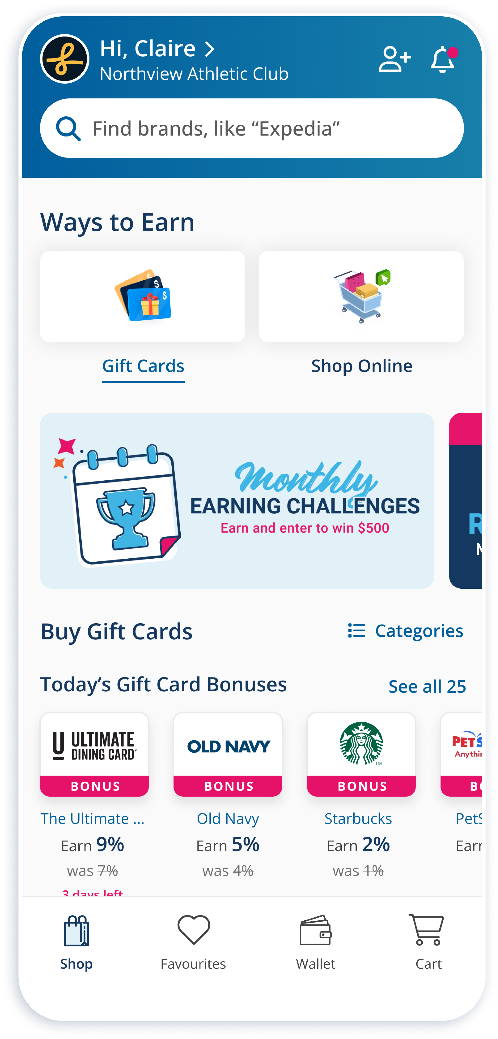

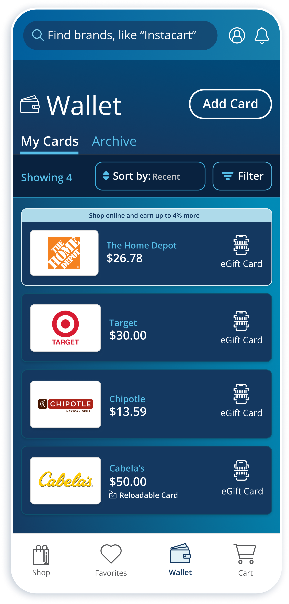


Earn on the go with the FlipGive app
Purchase eGift cards and shop online anywhere, anytime.
Instantly access your eGift cards and scan them at checkout while shopping, directly from your account Wallet.
Add funds to reloadable eGift cards anytime. Every time you add funds, you earn!
Download the FlipGive app for free

Slide 9
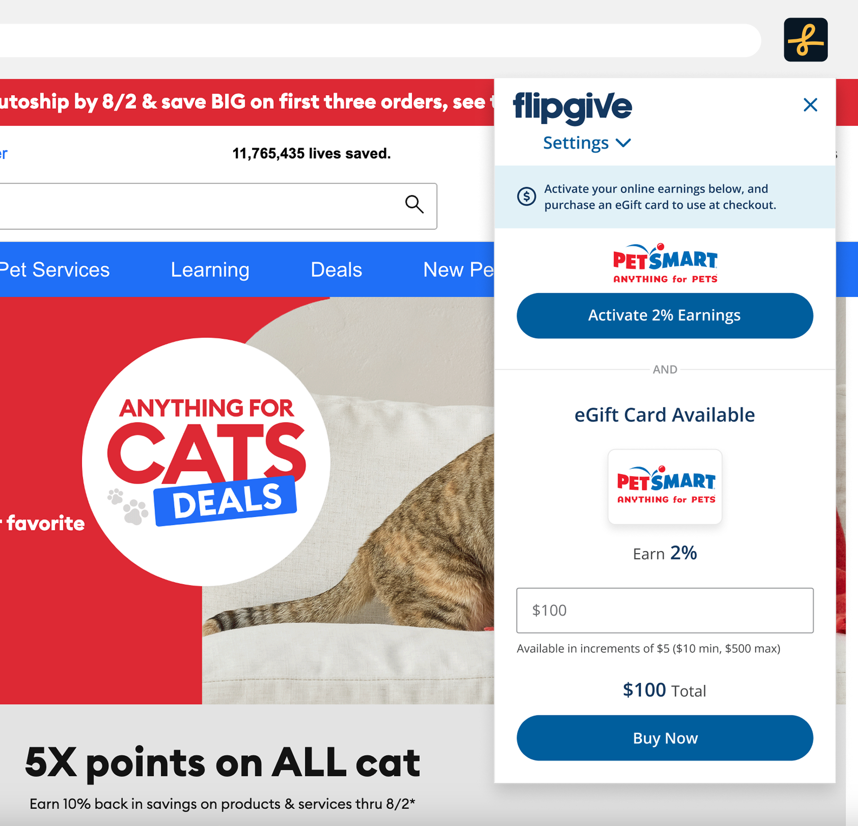
Never miss out on earnings while shopping online
Install the FlipGive Earnings Extension to your desktop browser to get real-time earning reminders while shopping online.
Conveniently activate online earnings in a single click.
Quickly buy eGift cards to use as payment for your online purchases.
Install for FREE on Chrome or Edge browsers and Safari on your iPhone

Slide 10



eGift Cards
Gift cards for every kind of shopper
Digital gift cards that are delivered instantly to your account “Wallet,” and accessible right from your phone—they can be scanned by the retailer for quick checkout.
Whether you're an online, contactless shopper, or prefer to have your card in-hand, there is a gift card type available for you.
Reloadable eGift Cards
Allow you to electronically add more funds onto existing reloadable eGift cards purchased from FlipGive.
2 easy payment options are available: Purchase gift cards securely and directly using a debit card or credit card.

Slide 11


1. Join the program
Scan the QR Code or sign up at FlipGive.com/Enroll using the enrollment code provided by [COORDINATOR NAME].
How to get started
Scan the QR code to join [ORG NAME]’s FlipGive program and start earning.
2. Create a secure account
Complete the short signup form.
DOWNLOAD THE QR CODE FROM YOUR COORDINATOR DASHBOARD. DRAG & DROP IT HERE
3. Start earning
Buy eGift cards from hundreds of popular brands.
For more information, contact our program coordinator:
[COORDINATOR NAME]
[COORDINATOR EMAIL / PHONE]

